Slide 1

Sales Development Plans
Why Bother?
GSSI Conference June 2014
Jeremy Noad

Slide 2
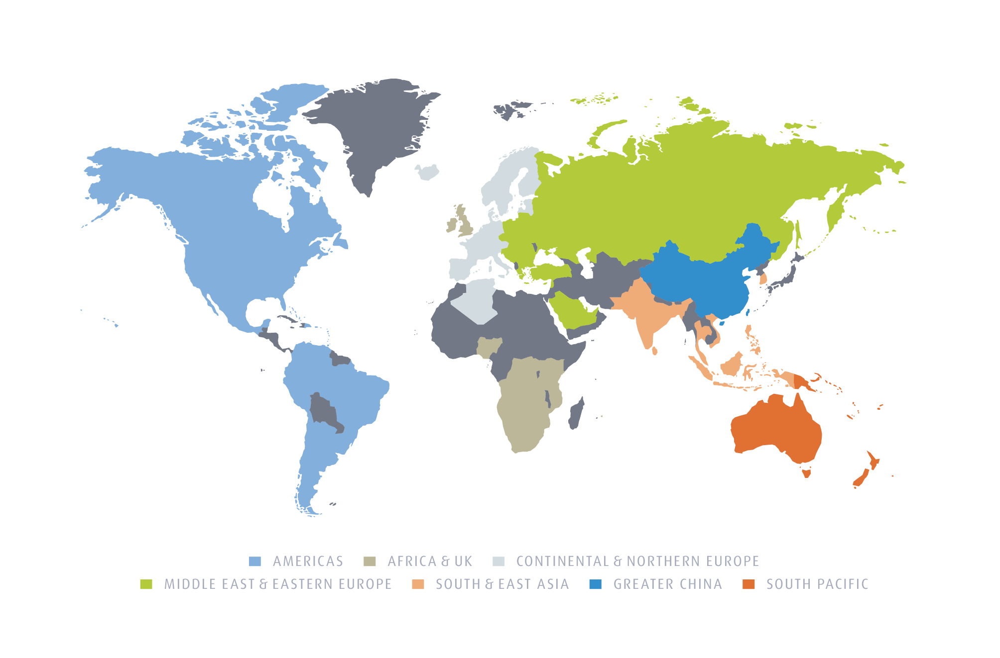
The Linde Group worldwide
Global presence in more than 100 countries
World # 1 Industrial Gases & Engineering business
2013 Group Revenue EUR 16.7bn Operating profit EUR 3.97bn
64,000 Employees

Slide 3
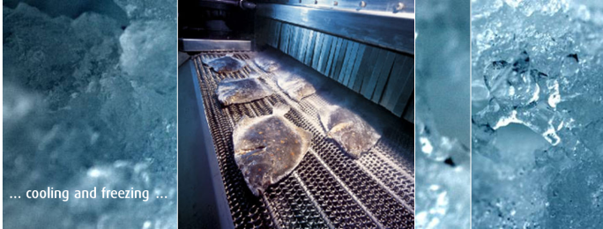
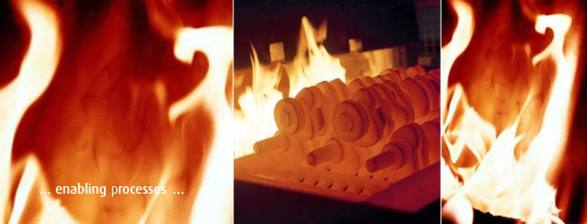



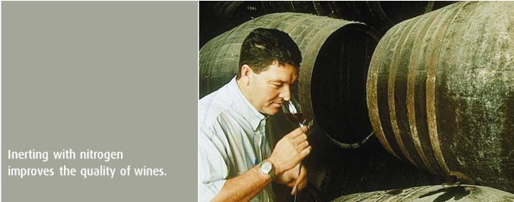


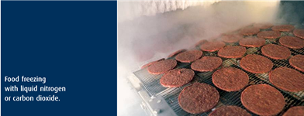



The Linde Group worldwide
In every part of Life
© Jeremy Noad 2014

Slide 4



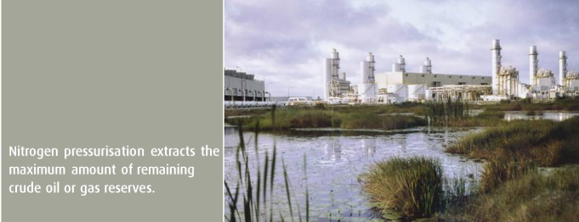

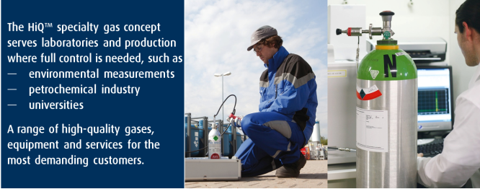
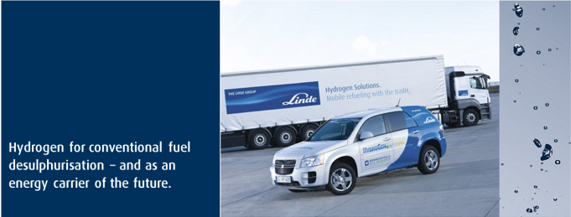





The Linde Group worldwide
In every part of Life
© Jeremy Noad 2014

Slide 5
What is a Sales Development Plan?
A sales development plan is a set of business activities.
It focuses on making a positive impact on performance.
It creates sustainable performance transformation in the organisation
It adjusts to the market conditions via a modular approach.
© Jeremy Noad 2014

Slide 6




Problem 1 – Where to focus?
The High Performance Organisation Challenge
Productivity Improvements
Synergies
Growth
Needed to :
Impact on performance positively
Transform performance sustainably
Implementable within existing constraints

Slide 7
The Outcome
Develop
Drive
High
Sales Manger Effectiveness
Disturb
Damage
Low
Sales Team Effectiveness
Low
High
Notes:
Disturb the status quo

Slide 8
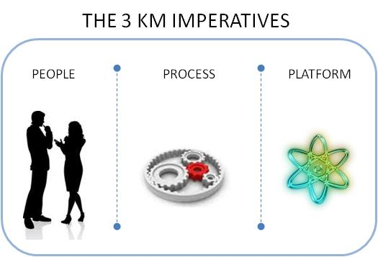
The Sales Manager has influence on
People are the biggest contributors to high performance; it’s what they do that counts | After the people, having the right processes is the next biggest factor in delivering high performance; Identifying and executing best practice | The platform can help improve or increase the speed of the processes; access to knowledge, sales activities, customer & employee satisfaction, operational costs

Slide 9
The Sales Manager has influence on
External Factors
Environment
competition
Effectiveness
Factors
Sales force
actions
Customer Actions
Company Results
Company
Strategy
Marketing &
Sales Strategies
Adapted Zoltners, Sinha Lorimar 2008

Slide 10
The background:
The role of a
Sales Manager
Drivers of
Sales Effectiveness
Sales Development Plan
© Jeremy Noad 2014

Slide 11
The background:
The role of a
Sales Manager
Drivers of
Sales Effectiveness
No longer needed
Locally developed materials
Minimise
or remove activities
SDP
Optional
Activities
© Jeremy Noad 2014

Slide 12


Looking for the Silver Bullets
Reviewed Literature – Peer reviewed Journals
+ ve large content on individual sales person
- ve minimal blended approaches
- ve minimal on actual application and outcome
Reviewed Trade bodies
+ ve case studies on application
+ ve toolkits for their preferred options
© Jeremy Noad 2014

Slide 13
Primary Research
Step 1 : Survey of sales Professionals (External to Company) -
Global participation across many market sectors ( albeit small response rates (less than 200))
Outputs around priorities of the sales manager in building high performing sales team
Step 2 : Qualitative Interviews with senior Linde sales Directors / VPs across 10 countries

Slide 14
The Focus Areas:
Sales
Organisation
Design
Tool to analyse
each country
Role Clarity
Hire Right
Understand
Current
situation
Capability
Development
Goal setting
& Appraisals
A way to
track progress
A way to
Track
performance
Pipeline
Management
Coaching

Slide 15
Business Process Maturity was identified as the best possible global Solution. (Francis 2007, Robinson 2006, Škrinjar 2008).
Business Processes relating to effectiveness drivers were mapped on a Excel tool .
The Excel tool was used to create a bench mark and a target for each countries sales organisation.
An assessment process established in 2010.
Initial Country Review
(Benchmark)
Maturity
Roadmap Outputs
Annual Country Review
Action Plans
Win
Measure
Implement
Win
© Jeremy Noad 2014
Notes:
2010 1st Pilot, & roll out to top 30 countries
2013 Reboot apply lessons and update v progress , broaden scope to top 50 countries.

Slide 16
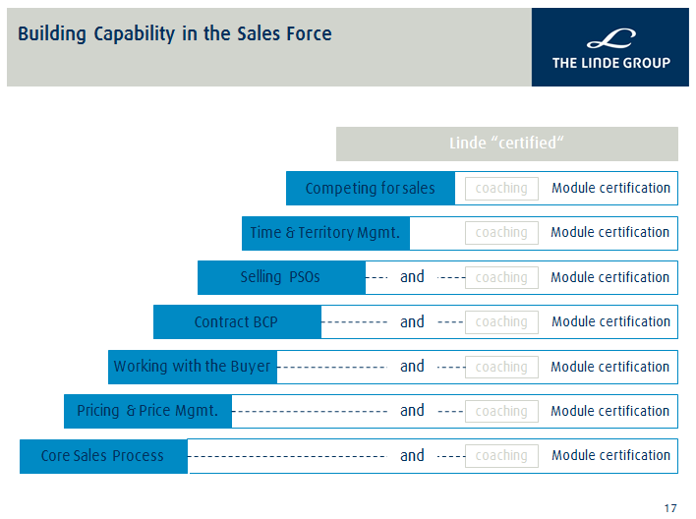
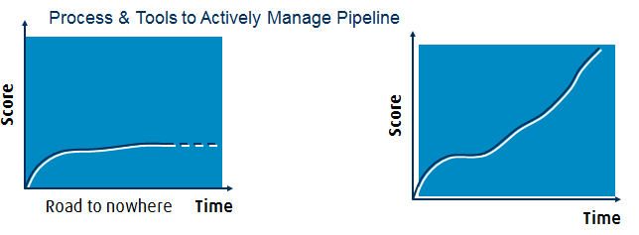
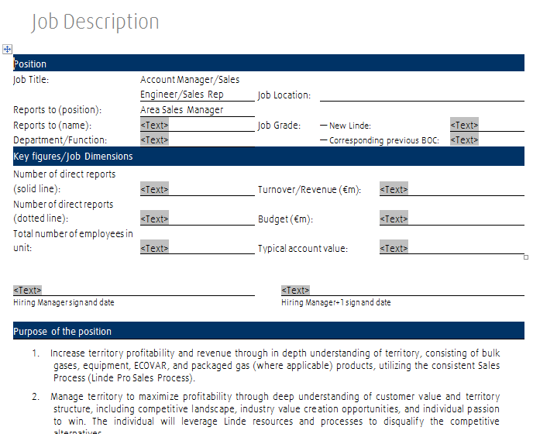
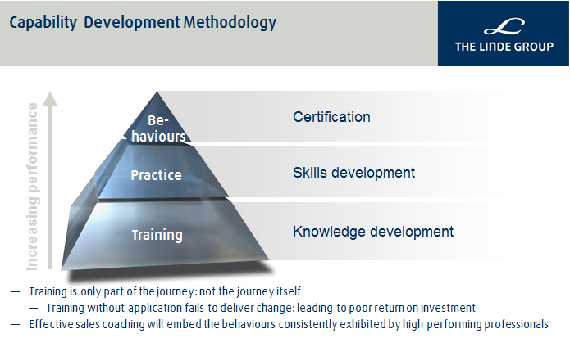
Programmes to Support the Country Action Plans
Org Design & Role Clarity: Global Role Profile Frameworks
Global Recruitment & Onboarding Framework
© Jeremy Noad 2014

Slide 17

Coaching
Coaching Syllabus created and deployed across Group
600+ Sales Managers trained in Sales coaching and Certified.
320 Level 2 Sales Coaches certified.
© Jeremy Noad 2014

Slide 18
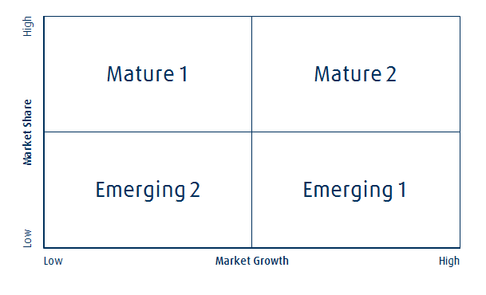
4 Distinct Sales Manager Effectiveness Profiles identified.
Measured against 2 Global Standard KPI’s.
4 Models available countries dependant of their market position.
© Jeremy Noad 2014

Slide 19
In Summary
Effective Sales Development Plans are multi - element.
Require time to implement
Need to be supported by robust measures.
For Sales it is better to focus on those topics within direct control to implement and manage.
Different effectiveness drivers apply to different markets.
© Jeremy Noad 2014

Slide 20
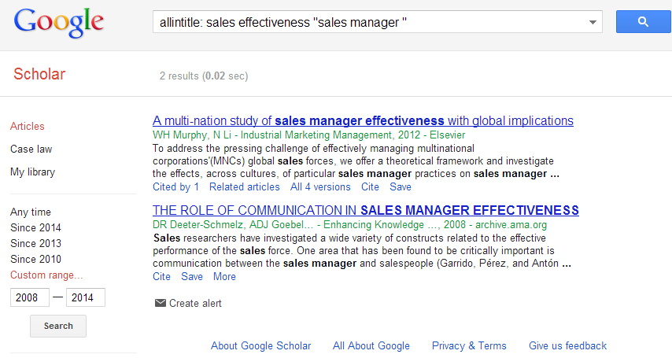
Final Thoughts
Only 68 out 1012 Journal Articles concerning sales topics published between 1983 -2002 were on sales management. ( Williams & Plouffe 2007)
Google Scholar only shows 2 Sales Manager Effectiveness articles in past 6 years
Few articles detail any application of idea or concept

Slide 21

Questions
© Jeremy Noad 2014

Slide 22

Learning to be excellent…
…on the way to LeadIng.
Jeremy Noad
Global Performance Transformation Lead - Customer Management & CRM
Jeremy.noad@linde.com
+44 776 803 1817
© Jeremy Noad 2014

Slide 23
References
Sales Force Effectiveness: A Framework for Researchers and Practitioners
Andris AA Zoltners, Prabhakant Sinha, Sally E. SE Lorimer (2008)
Journal of Personal Selling and Sales Management 28 (2) p. 115-131
Assessing the evolution of sales knowledge: a 20-year content analysis.
Williams, B. C., & Plouffe, C. R. (2007).
Industrial Marketing Management,36(4), 408-419
What have we learned? Themes from the literature on best-practice benchmarking
Graham Francis, Jacky Holloway (2007)
International Journal of Management Reviews 9 (3) p. 171-189
The impact of business process orientation on financial and non-financial performance
Rok Škrinjar, Vesna Bosilj-Vukšic, Mojca Indihar-Štemberger (2008)
Business Process Management Journal 14 (5) p. 738-754
STEPS: a knowledge management maturity roadmap for corporate sustainability
H.S. Robinson, C.J. Anumba, P.M. Carrillo, A.M. Al-Ghassani (2006)
Business Process Management Journal 12 (6) p. 793-808
© Jeremy Noad 2014

