Slide 1
The new roles of marketing and selling in creating shareholder value by Emeritus Professor Malcolm McDonald
GSSI 13th June 2014

Slide 2
A brief history of marketing
The limited value of P and L statements and Balance Sheets
How marketing and sales have changed forever
Why excellent marketing is an essential prerequisite for successful selling
The roles and skills needed for excellent selling

Slide 3
A brief history of management
Technology
Production
Sales
Accountancy
Fads
Marketing

Slide 4
FADS (300)
In Search of Excellence
Marketing Warfare
One Minute Manager
MBWA
Skunk Works
7 Ss
Etc.

Slide 5
LOVE
HATE
High
Sales
Potential
Low

Slide 6
Inter Tech’s 5 year performance
Performance (£million)
Base Year
1
2
3
4
5
Sales Revenue
- Cost of goods sold
£254
135
£293
152
£318
167
£387
201
£431
224
£454
236
Gross Contribution
- Manufacturing overhead
- Marketing & Sales
- Research & Development
£119
48
18
22
£141
58
23
23
£151
63
24
23
£186
82
26
25
£207
90
27
24
£218
95
28
24
Net Profit
£16
£22
£26
£37
£50
£55
Return on Sales (%)
6.3%
7.5%
8.2%
9.6%
11.6%
12.1%
Assets
Assets (% of sales)
£141
56%
£162
55%
£167
53%
£194
50%
£205
48%
£206
45%
Return on Assets (%)
11.3%
13.5%
15.6%
19.1%
24.4%
26.7%
From The Marketing Process Company

Slide 7
Why Market Growth Rates Are Important
InterTech’s 5 Year Market-Based Performance
Performance (£million)
Base Year
1
2
3
4
5
Market Growth
18.3%
23.4%
17.6%
34.4%
24.0%
17.9%
InterTech Sales Growth (%)
Market Share(%)
12.8%
20.3%
17.4%
19.1%
11.2%
18.4%
27.1%
17.1%
16.5%
16.3%
10.9%
14.9%
Customer Retention (%)
New Customers (%)
% Dissatisfied Customers
88.2%
11.7%
13.6%
87.1%
12.9%
14.3%
85.0%
14.9%
16.1%
82.2%
24.1%
17.3%
80.9%
22.5%
18.9%
80.0%
29.2%
19.6%
Relative Product Quality
Relative Service Quality
Relative New Product Sales
+10%
+0%
+8%
+8%
+0%
+8%
+5%
-20%
+7%
+3%
-3%
+5%
+1%
-5%
+1%
0%
-8%
-4%
From The Marketing Process Company

Slide 8
Measurement of segment profitability
Total
Market
Segment
1
Segment
2
Segment
3
Segment
4
Segment
5
Segment
6
Percentage of market
represented by segment
Percentage of all profits in
total market produced by
segment
Ratio of profit produced by
segment to weight of
segment in total population
Defection rate
100.0
100.0
1.00
23%
14.8
7.1
0.48
20%
9.5
4.9
0.52
17%
27.1
14.7
0.54
15%
18.8
21.8
1.16
28%
18.8
28.5
1.52
30%
11.0
23.0
2.09
35%

Slide 9
Balance sheet
Assets
Liabilities
- Land
- Buildings
- Plant
- Vehicles
etc.
- Shares
- Loans
- Overdrafts
etc.
£100 million
£100 million
© Professor Malcolm McDonald, Cranfield School of Management

Slide 10
Balance sheet
Assets
Liabilities
- Land
- Buildings
- Plant
- Vehicles
etc.
- Shares
- Loans
- Overdrafts
etc.
£100 million
£900 million
© Professor Malcolm McDonald, Cranfield School of Management

Slide 11
Balance sheet
Assets
Liabilities
- Land
- Buildings
- Plant
- Vehicles
- Shares
- Loans
- Overdrafts
etc.
Goodwill £800m
£900 million
£900 million
© Professor Malcolm McDonald, Cranfield School of Management

Slide 12
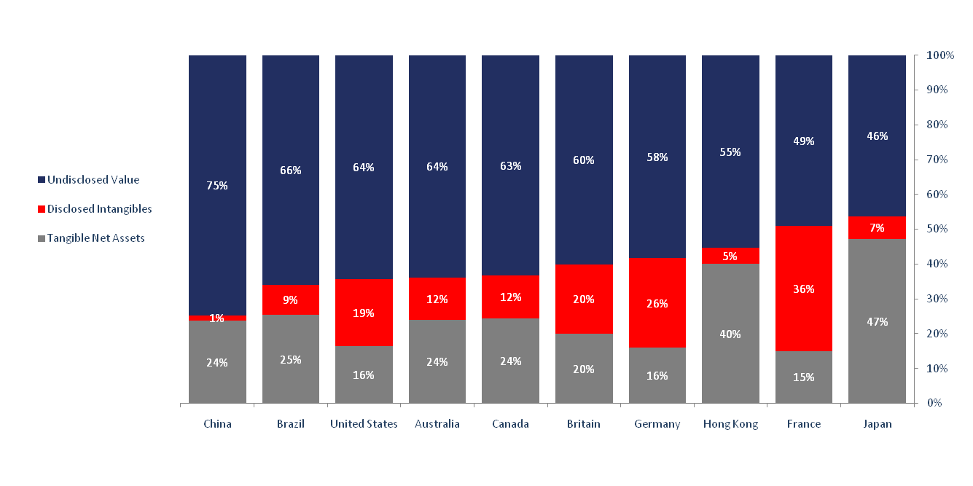
Asset Breakdown for the top 10 countries by Enterprise Value (US$ millions, 2011)

Slide 13
Intangibles
  P and G paid £31 billion for Gillette, but bought only £4 billion of tangible assets
  Gillette brand £ 4.0 billion
  Duracell brand £ 2.5 billion
  Oral B £ 2.0 billion
  Braun £ 1.5 billion
  Retail and supplier network £10.0 billion
  Gillette innovative capability £ 7.0 billion
  TOTAL £27.0 billion
  (David Haigh, Brand Finance, Marketing Magazine, 1st April 2005)

Slide 14
Marketing: existential malpractice and an etherised discipline; a soteriological comment
JMM Vol 20. 3-4. April 2004 ( pp 387-408 )

Slide 15
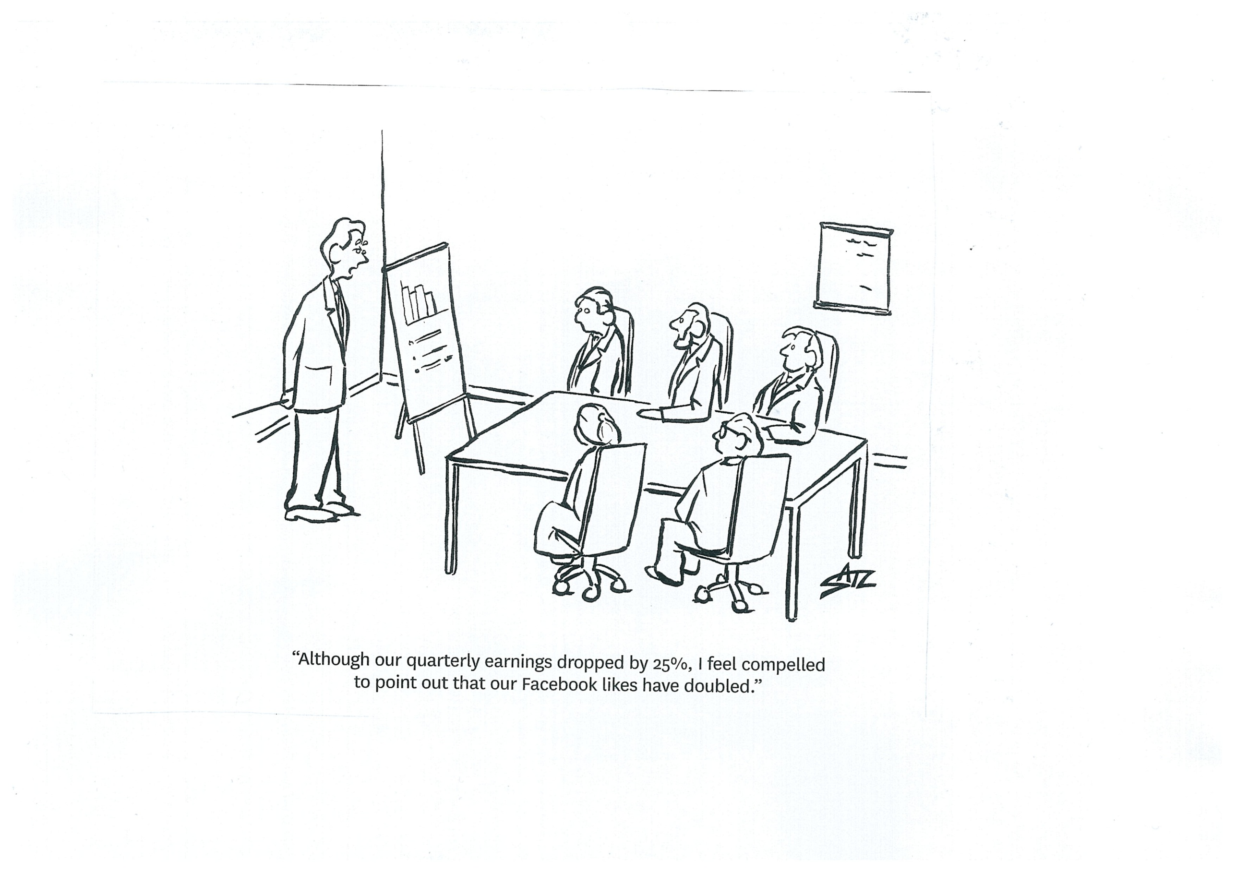

Slide 16
The world of marketing and sales has changed forever and why we need excellent marketing

Slide 17
New global leaders
Leaders
?
2nd tier
New guerrillas
Guerrillas
Embrionic markets
Growing markets
Mature markets

Slide 18
The customer portfolio
Customer Sales/
Potential
Large
Key
Accounts
Developers
Major
Accounts
Conventional
Middle
Market
Direct
Channels
Over-
Demanders
Customer
Relationship/
Service
Requirements
Small
Low
High

Slide 19
The widening rift between profitable and unprofitable customers:
% of company profit by customer decile (each decile = 10% of client base)
% of total
% of total
company
t-15
company
t.o
profits
profits
29
17
16
26
15
22
13
20
12
10
7
8
6
4
4
1
-3
-3
-3
1
1
2
2
3
3
4
4
5
5
6
6
7
7
8
8
9
9
10
1
10
1
2
2
3
3
4
4
5
5
6
6
7
7
8
8
9
9
10
Largest 10%
10
Largest 10%
Smallest 10%
Smallest 10%
of clients
customer decile groups
of clients
of clients
customer decile groups
of clients
Adapted from: ‘Profitable customers’ by Charles Wilson

Slide 20
Strategic Purchasing
SUPPLIER PREFERENCE
A
T
T
R
A
C
T
I
V
E
N
E
S
S
Development
Core
Nurture account
Expand Business
Seek New
Opportunities
Cosset account
Defend Vigorously
High Level of Service
High Responsiveness
Nuisance
Exploitable
Give Low Attention
Lose Without Pain
Drive Premium Price
Seek Short Term Adv.
Risk Losing account
VALUE OF BUSINESS
Based on: Kraljic P HBR 1st Sept 1983 adapted by PIMS )

Slide 21
Differentiation is at the heart of successful marketing
“For marketers, differentiation today is more challenging than at any time in history – yet it remains at the heart of successful marketing. More importantly, it remains the key to a company’s survival.”

Slide 22
YOU MUST BE ABLE TO PROVE THAT DEALING
WITH YOU WILL CREATE ADVANTAGE FOR
YOUR CUSTOMER, NOT MERELY HELP THEM
TO AVOID DISADVANTAGE.

Slide 23
Value proposition usage
60 – 70% of UK companies use the term within their companies
Only 5% of UK companies have got clearly articulated written value propositions.
Source: McKinsey

Slide 24
Customer value
Added value (eg revenue gains, service enhancement, speed etc)
Cost reduction
Cost avoidance
Emotional contribution (eg “feelgood factor", trust, confidence self esteem, risk reduction etc )

Slide 25
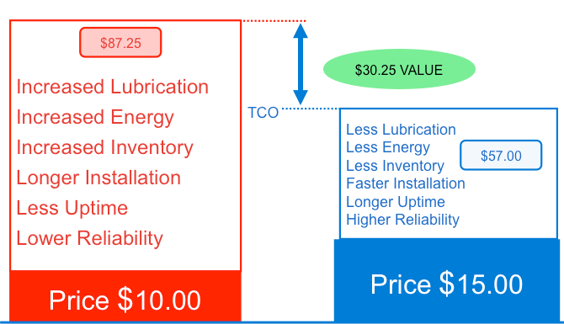
SKF quantified value proposition
Source: SKF

Slide 26
Support Activities
Infrastructure
- Legal, Accounting, Financial Management
Human Resource
Management
- Personnel, Pay, Recruitment, Training,
Manpower Planning, etc
Product & Technology
Development
- Product and Process Design, Production Engineering,
Market Testing, R&D, etc
Procurement
- Supplier Management, Funding,
Subcontracting, Specification
Value
Added - Cost
= Profit
INBOUND
LOGISTICS
OPERATIONS
OUTBOUND
LOGISTICS
SALES &
MARKETING
SERVICING
eg.
Quality Control
Receiving
Raw Material
Control
etc
eg.
Manufacturing
Packaging
Production
Control
Quality Control
Maintenance
etc
eg.
Finishing Goods
Order Handling
Despatch
Delivery
Invoicing
etc
eg.
client mgmt
Order Taking
Promotion
Sales Analysis
Market
Research
etc
eg.
Warranty
Maintenance
Education /
Training
Upgrade
etc
Primary Activities
Many activities cross the boundaries - especially information based activities such as:
Sales Forecasting, Capacity Planning, Resource Scheduling, Pricing, etc

Slide 27
Tetra Pak is a multi-stage, multi-level partner
Channel selection
Supply chain analysis
Equipment selection & financing
Installation & start-up
Operational fine-tuning & process flow
Equipment maintenance and parts
Wholesale and retail distribution process flow
Determine food packaging and performance objectives:
  Product quality
  Liters of output per hour
  Sustainability targets
Determine distribution requirements :
  Shipping frequency and method
  Wholesale and retail shelf space
  Weight constraints
Select machinery and packaging
Provide equipment financing
Management training
  15 “Train the Trainer” centers
Test machinery and factory process flow
Quality testing with distributors
Hone product quality
On-site ops. and maintenance training
Increase employee productivity and maximize availability of equipment
  Human error accounts for most equipment failure
Optimize parts inventory management
  4 distribution centers for parts
Optimize QC: Who does what to what equipment, when and how
  Access to 65 tech service centers
Periodic factory review
  Avoid “if it ain’t broke, don’t fix it”-mentality
Periodically obtain feedback
  Wholesaler and retailers
Incorporate feedback into next iteration design
Source: http://www.fao.org/ag/AGS/publications/docs/AGST_WorkingDocuments/J7193_e.pdf
Notes:
27

Slide 28
The customer is simply the fulcrum of the business and everything the company does, from supply chain, production, finance, people, risk management and the way it addresses the concerns of other stakeholder groups, all adapt to and converge on the business value proposition that is projected to the customer.
Professor Malcolm McDonald, 2007

Slide 29
Corporate objectives and strategies
Corporate Objective ( what ): Profit
Corporate Strategies ( how ):
  facilities ( operations, R & D, IT, distribution etc )
  people ( personnel )
  money ( finance )
  products and markets ( marketing )
  other ( CSR, image etc )

Slide 30
The overall purpose of marketing is the identification and creation of sustainable competitive advantage.
Page 30
Notes:
Thursday, 05 June 2014
Group name goes here
30

Slide 31
Shareholder value-adding strategies

Slide 32
Map of the marketing domain
Define markets
& understand
value
Asset
Base
Monitor
value
Determine
value
Proposition
Deliver
value

Slide 33
Strategy
Ineffective
Effective
Die
(quickly)
Efficient
Thrive
Tactics
Die
(slowly)
Inefficient
Survive

Slide 34
A Salesperson
Clever
Stupid
Lazy
✓ ✓ ✓
✓
Hard
working
✓ ✓
✓ ✓
❒

Slide 35
The contents of a strategic marketing plan (T+3)
(less than 20 pages)
Financial summary
Market overview
  how the market works
  key segments and their needs
SWOT analyses
Portfolio summary
  of SWOTs
Assumptions
Objectives and strategies
Budget for 3 years

Slide 36
The value chain
Provider
Customer
Consumer
© Professor Malcolm McDonald, Cranfield School of Management

Slide 37
Market Map - Office Equipment
Direct
Field Sales
7%
3%
Type A
Dealer Chain
Colours
Red Black
Type A
Independent
9%
3%
53%
14%
Type B
Dealer Chain
0%
3%
Type B
Independent
1%
8%
Type C
Dealer Chain
15%
7%
Manufacturers
Final Users
Type C
Independent
4%
18%
VARs
5%
4%
Buying
Consortia
4%
10%
Final Users Route to Market
(black)
Retail
2%
10%
Company’s Route to Market
(red)
Direct
Response
0%
8%
Other
0%
12%

Slide 38
Manufacturers
140 units
1300 units
Total market - 1300 units
100%
Company's share - 11%
460
Distributor
140 units
(460) - Units decided on
(owned)
100%
Sales force
1160 units
0%
1300 units
140 units
300 units
240 units
420 units
0%
7%
17%
19%
Buying groups
40 units
140 units
140
0%
60 units
40 units
200 units
0%
0%
0%
Administration
360 units
300
300 units
7%
60 units
Leading
160
20 units
0%
institutions
0%
Technicians
20 units
0%
620 units
240
200 units
620 units
10%
Final users
1300 units
460
160 units
0%

Slide 39
Radiator market map
Primary Leverage Point
Radiator Manufacturer
Distributor
Installer
Specification Decision
End User Segment
Distribution
Sector
Share
Manufacturer
250
10
11
12
13
14
Nil
250
Nil
Nil
Nil
31.3
10.
Private
Exitsting
2555
46.8%
5
6
7
8
9
385
2010
100
80
Nil
Stelrad
2275
41.7%
1
2
3
4
1830
360
66
Nil
70.2
17.3
11.2
Nil
5.
British Gas
465
8.5%
1
2
3
4
295
170
Nil
Nil
1.
National
Merchants
2605
47.8%
Local
Authority
1350
10
11
12
13
14
Nil
Nil
1050
50
250
95.4
50.0
27.8
Premier
860
15.8%
1
2
3
4
555
280
26
Nil
21.3
12.8
4.3
Nil
11.
Private New
800
14.7%
5
6
7
8
9
Nil
50
750
Nil
Nil
6.
Installer
2755
50.5%
1
2
3
4
1065
1360
360
Nil
2.
Large
Independents
2190
40.1%
Housebuilder
350
10
11
12
13
14
Nil
350
Nil
Nil
Nil
43.8
Supaline
605
11.1%
1
2
3
4
125
450
30
Nil
4.8
20.5
5.1
Nil
7.
Contractor
1905
34.9%
1
2
3
4
1135
540
230
Nil
12.
Public
Existing
1100
20.2%
5
6
7
8
9
50
395
506
Nil
150
3.
Barlo
480
8.8%
1
2
3
4
90
270
120
Nil
3.4
12.3
20.7
Nil
Small
Independents
560
10.6%
British Gas
700
10
11
12
13
14
500
100
50
Nil
50
19.6
12.5
4.5
5.6
8.
Self Installer
80
1.4%
1
2
3
4
Nil
Nil
Nil
80
13.
Public New
100
1.8%
5
6
7
8
9
Nil
Nil
Nil
Nil
100
Warmastyle
300
5.5%
1
2
3
4
5
255
40
Nil
Nil
11.6
6.9
Nil
Contractor
200
10
11
12
13
14
Nil
100
Nil
Nil
100
12.5
11.1
4.
Sheds
80
1.4%
9.
Direct Works
250
4.6%
1
2
3
4
120
130
Nil
Nil
Other Imports
905
17.1%
1
2
3
4
Nil
556
300
80
Nil
25.3
51.8
100.0
14.
Commercial
900
16.5%
Consultant
550
10
11
12
13
14
Nil
Nil
Nil
50
500
50.1
55.6
5
6
7
8
9
50
300
550
Nil
Nil
5455
5455
5455
3400
623
5455

Slide 40
Market segmentation
Do we address real segments in our key target markets?
Notes:
From Marketing Strategy to Share Price – by Professor Malcolm McDonald
Aston MBA, 6th October 2009

Slide 41
Listen to how customers talk about category need
Customer View
Advice
cutting costs
future technology direction
Help
design & configuration
process engineering
electron commerce
Run
international network
disaster recovery
Supplier View
fast PAD family
multimedia FRADs
PIX firewall
Solutions
Gigabit Ethernet
solutions
high performance
LAN support

Slide 42
Understand the different category buyers
Business
Business
perfectionist
Save my
budget
Radical thinkers
Business
general
Profit engineer
“Reward”
“Relief”
Radical
architect
Save my
career
Technical
idealist
Conservative
technocrat
Technical

Slide 43
STRENGTHS
WEAKNESSES
WRONG
OPPORTUNITIES
THREATS
Page 43

Slide 44
Setting expectations of performance
high
high/
medium
Supplier business strength with segment
High Low
High
Strategic
Strategic
Star
Star
Strategic
Strategic
Selective
Selective
investment
investment
investment
Mkt/Segment
attractiveness
investment
Status
Status
Streamline
Streamline
medium
low
Manage for
Pro
Manage for
Pro
-
-
active
-
active
cash
maintenance
cash
Low
maintenance
key: p= profit c= costs g= growth

Slide 45
Key Account Selection Matrix Tool - KA Selection Matrix
X
http://www.TheMarketingProcessCo.com
_______________
Chart
Display Spend:
Spend with Us
clients on Chart
Display Group:
National
Show Groups
Redraw
X
ID
Name
Maximum Spend
High
1 Alexander Smith $14,000,000
2 Ash & Williams $13,000,000
3 College Group $12,000,000
4 F T Group $9,900,000
5 Harpers $7,600,000
6 Parker $9,400,000
7 Quality Insurers $16,200,000
8 Randsome $14,500,000
9 Royal & Co $6,400,000
10 Thompson Group $32,000,000
11 Tudor Rose $8,000,000
12 Woods $11,500,000
2
Supplementary
Service Elements
7
10
4
12
Account Attractiveness
5
3
1
11
Relationship Stage
6
X
8
9
Exploratory
Integrated
Supplementary
Service Elements
Low
High
Low
Basic
Relative client Satisfaction
Interdependent
client: College Group Relative client Satisfaction: 0.80 Account Attractiveness: 4.40 Spend
Co-operative

Slide 46
Strategies suggested by portfolio matrix analysis
INVEST FOR GROWTH:
Gain / Defend leadership
Accept moderate short-term profits and negative cash flow
Geographic expansion, product line expansion, product differentiation
Aggressive marketing posture - selling, advertising, pricing, sales promotion, service levels etc.
OPPORTUNISTIC:
Move to left if resources are available
Keep a low profile until resources are available
Divest to a buyer able to exploit the opportunity
Higher
MARKET SEGMENT ATTRACTIVENESS
MAINTAIN / MANAGE FOR SUSTAINED EARNINGS:
Manage key product lines, prune less successful product lines
Differentiate products to maintain share
Limit marketing expenditure
Stabilize prices except where a temporary aggressive stance is needed
SELECTIVE / MANAGE FOR PROFIT & CASH:
Acknowledge low growth
Identify / exploit growth segments
Emphasise quality, avoid commodity
Improve productivity
Prune product line aggressively, maximise cash flow, minimise marketing expenditure, maintain or raise prices at expense of volume.
Lower
Higher Lower
RELATIVE BUSINESS STRENGTH

Slide 47
The historic rift between marketers and the finance department, caused by marketing’s reluctance to be accountable for what they do, is as marked as ever.
“Marketers have constantly hidden behind a fog of measures that are based purely on tactical marketing
activity, rather than solid financial metrics that are relevant to the City”.
Tense relations between CFOs and Marketers are dividing boardrooms over the value of marketing.
One in three CFOs said they did not believe marketing to be crucial in determining strategy.
“Marketing in 3D”
Deloitte

Slide 48
What is Marketing Due Diligence?

Slide 49
Profit improvement
Productivity improvement
Sales growth
Existing assets
Change
asset base
Market
penetration
Market
development
Product
development
Improve
Asset
Utilisation
(eg more/
better
sales calls)
Cost
reduction
Improve
Product/
Customer
mix
Increase
Price/
Reduce
discounts
Take
competitors’
customers
New
segments
Convert
Non-users
Existing
markets
New
markets
Increase
usage
Cash and margin focus
Growth focus
Investment
Acquisition
Joint ventures
etc
Divestment
Redevelopment
of capital resources
Capital Utilisation focus

Slide 50
Over 40 years of research into the link between long run financial success and excellent marketing strategies reveal the following:
Excellent Strategies
Target needs based segments
Make a specific offer to each segment
Have clear differentiation, positioning and branding
Leverage their strengths and minimise their weaknesses
Anticipate the future
Weak Strategies
Target product categories
Make similar offers to all segments
Have no differentiation and poor positioning and branding
Have little understanding of their strengths and weaknesses
Plan using historical data

Slide 51
Key Elements of World Class Marketing
A deep understanding of the market place
Correct needs-based segmentation and prioritisation
Segment-specific propositions
Powerful differentiation, positioning and branding
Effective strategic marketing planning processes
Long-term integrated marketing strategies
A deep understanding of the needs of major customers
Market/customer-driven organisation structures
Professionally-qualified marketing people
Institutionalised creativity and innovation
Notes:
Strategic Marketing for Directors and Senior Managers

Slide 52
The relational development model
Integrated
Strategic intent of seller
Interdependent
Cooperative
Basic
Exploratory
Strategic intent of buyer
Adapted from a model developed by Millman, A.F. and Wilson, K.J.
“From Key Account Selling to Key Account Management” (1994)

Slide 53
Exploratory
Basic
Selling company
Buying company
Directors
Directors
Purchasing Manager &
Key Account Manager
Inbound logistics &
Order processing/
client service?
Co-operative
Production
Production
Accounts
Accounts
Marketing
Marketing
Service
Service
Interdependent
Integrated

Slide 54
Business partnership process
1
Market / segment
selection criteria
Client’s
Basic
CSF
Analysis
Process
2
Defining and selecting
target key accounts
Industry driving forces
analysis
The Applications
Portfolio Analysis
3
For each key account
4
Client’s objectives
analysis
Strategic
High Potential
Gaining
Advantage
Our
objectives,
strategies
and plan
for T + 3
Client’s annual report
summary and financial
analysis
5
Avoiding
Disadvantage
6
Client’s internal value
chain analysis
Key Operational
Support
Client’s buying process
and information needs
analysis
7
8
Our sales history with
the client
9
Competitive analysis

Slide 55
The market understanding process
Marketing
Sales
Mfg.
IT
Finance &
Accounting
HR
Logistics
R & D
Etc.
KA A
KA B
The “Marketing” Director
KA C
KA D
Etc.

Slide 56
Performance Measurement
Relationship Type
4
3
2
1
0
SUPPLIER APPROACH
LEVEL OF RELATIONSHIP DEVELOPMENT
Penetration into KA
Customer Interaction
Solution Selling
Customisation in Offer
Understanding Customers Business
Competitive Position
MUTUAL
UNDERSTANDING
KA PERCEPTION OF SUPPLIER
Current
In 2 Years
Customer’s Value Perception

Slide 57
Developing key account professionals
Commercial awareness
Interpreting business performance
Advanced marketing techniques
Business planning/strategy
Finance
Project management
Interpersonal skills

Slide 58
Appendix

Slide 59
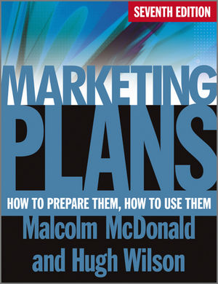

Marketing Plans 7e
59

Slide 60
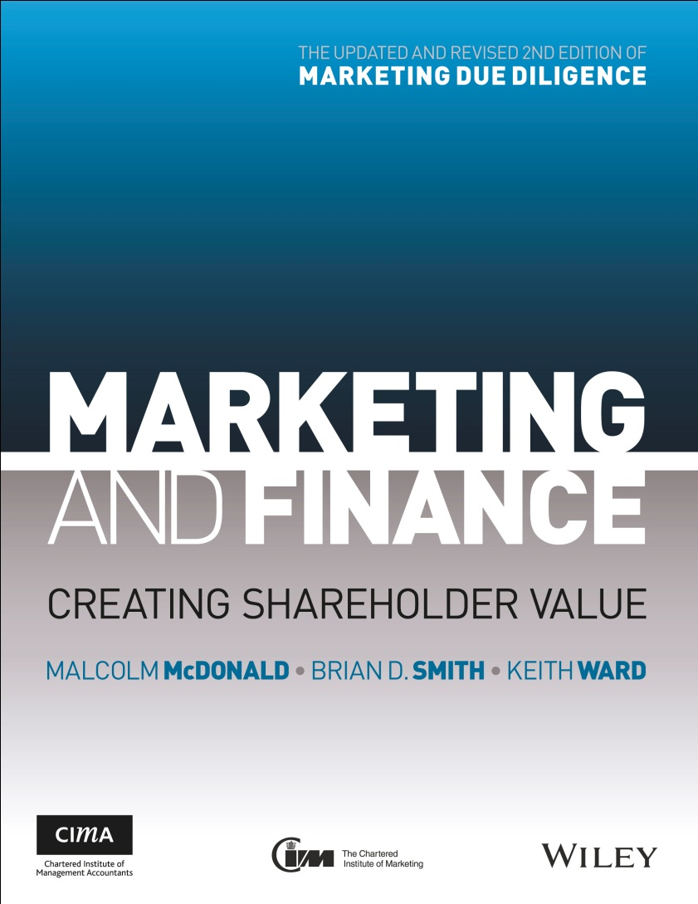

NEW BOOK! Marketing and Finance
The Updated and Revised 2nd Edition of Marketing Due Diligence
Marketing and Finance is a unique and essential addition to the library of senior marketing and finance professionals.
Includes Forewords from Anne Godfrey, Chief Executive, CIM and Charles Tilley, Chief Executive, CIMA
Available August 2013.
Available to purchase from:

Slide 61
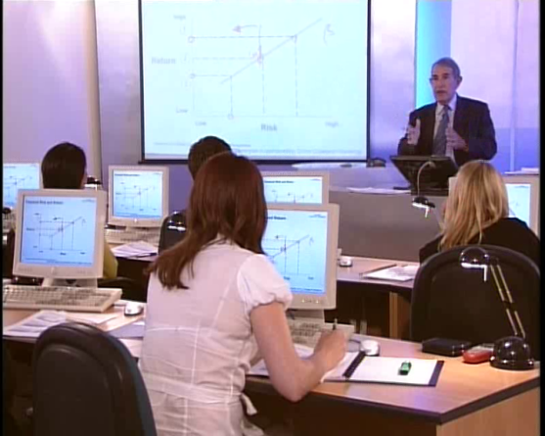
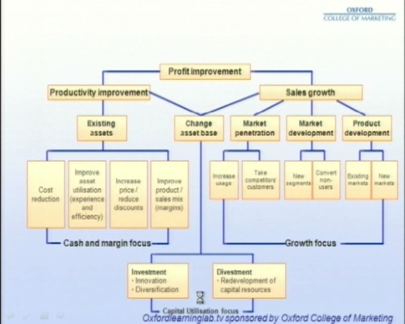
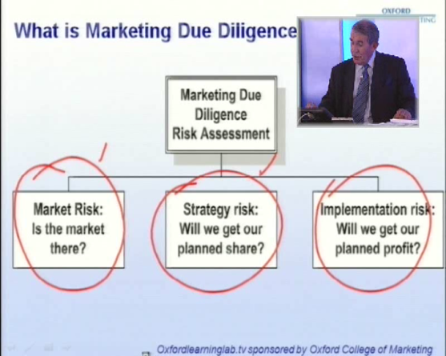
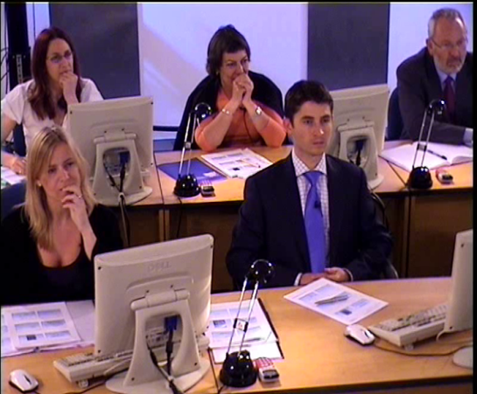
Prof. Malcolm McDonald free videos and downloads
@
www.oxlearn.com

Slide 62
“How good is your strategic
marketing plan ?"
Score out of 10
Market structure and segmentation
Is there a clear and unambiguous definition of the market we are interested in serving?
Is it clearly mapped, showing product/service flows, volumes/values in total, our shares and critical conclusions for our organisation?
Are the segments clearly described and quantified? These must be groups of customers with the same or similar needs, not sectors.
Are the real needs of these segments properly quantified with the relative importance of these needs clearly identified?
Differentiation
Is there a clear and quantified analysis of how well our company satisfies these needs compared to competitors?
Are the opportunities and threats clearly identified by segment?
Notes:
Profit – the role of world class strategic marketing planning
Professor Malcolm McDonald

Slide 63
“How good is your strategic
marketing plan ?"
Score out of 10
Scope
Are all the segments classified according to their relative potential for growth in profits over the next three years and according to our company’s relative competitive position in each?
Are the objectives consistent with their position in the portfolio? (volume, value, market share, profit)
Are the strategies (including products, services and solutions) consistent with the objectives?
Are the measurement metrics proposed relevant to the objectives and strategies?
Are the key issues for action for all departments clearly spelled out as key issues to be addressed?
Value capture
Do the objectives and strategies add up to the profit goals required by our company?
Does the budget follow on logically and clearly from all the above, or is it merely an add on?
Notes:
Profit – the role of world class strategic marketing planning
Professor Malcolm McDonald

